Slide 1
REAL-TIME-WEATHER-FORECASTING-APPLICATION

Slide 2
INTRODUCTION
The Real-Time Weather Forecasting Application in C is a powerful utility designed to provide users with up-to-the-minute weather information for any location worldwide.
Developed using the C programming language and leveraging the capabilities of the libcurl library for HTTP requests, this application offers a simple yet effective way to access essential weather data.

Slide 3
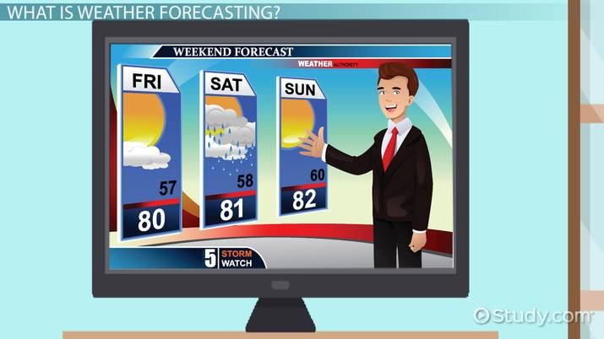

Slide 4
Key Features:
Data Retrieval: The application seamlessly retrieves real-time weather data from the OpenWeatherMap API, ensuring accuracy and timeliness.
User Interaction: With a user-friendly console interface, users can easily input their desired city or location and receive precise weather details.
Information at a Glance: Users can access vital weather information, including temperature, weather conditions, and location-specific data, all presented in a clear and concise format.

Slide 5
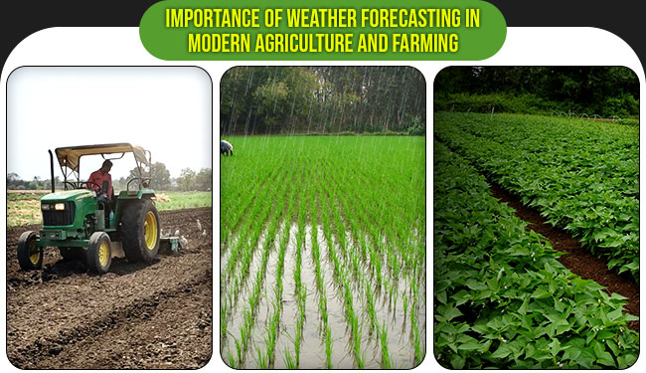

Slide 6
4.Error Handling: Robust error handling ensures that the application gracefully manages situations such as network issues or invalid user input.
5.Scalability: This application serves as a foundation for future enhancements, including the addition of graphical user interfaces (GUIs), unit conversion, and advanced features to cater to a wider audience.
Whether you're planning a trip, staying updated on local weather conditions, or exploring the intricacies of C programming, the Real-Time Weather Forecasting Application in C is a versatile tool that delivers essential weather insights with efficiency and accuracy. Experience weather forecasting like never before with this intuitive and informative application.

Slide 7


